Slide 1


DEPARTMENT OF CIVIL ENGINEERING
PLANNING, ANALYSIS AND DESIGN OF INDIRAMMA ILLU BY MANUAL PROCESS
Under the Guidance of
SK. SHANAVAZ AHMED (HOD)
Submitted By
SA RAHMAN 24365A0125
ANJALI K 24365A0102
SIDDARTHA V 24365A0121
AMERSALEEM 23361A0102

Slide 2
BACKGROUND & PROJECT OBJECTIVE
  The Indiramma Illu Scheme: Launched by the Government of Telangana on March 11, 2024, to address the housing deficit for Economically Weaker Sections (EWS) and Below Poverty Line (BPL) families.
  Financial Model: The scheme provides direct financial assistance of ₹5 lakh to families who own a plot but lack construction funds.
  Primary Objective: The planning, Structural analysis, and designing of an Indiramma Illu strictly through a manual process.
  Design Goal: To engineer a highly efficient, single-story (G+0) residential building that maximizes space while strictly adhering to the scheme's economic constraints.
  The Methodology: The entire structural design is executed completely manually.
  Execution: Every phase, from architectural planning and load calculations to structural analysis and RCC design, is calculated strictly by hand instead of relying on automated structural software.
  Cost Control: This rigorous manual approach actively avoids the unnecessary, cost-inflating designs that often result from an over-reliance on complex analytical software.

Slide 3
REAL-WORLD SITE DATA
Practical Approach: Surveyed an actual shortlisted plot on the ground instead of assuming standard textbook dimensions.
Beneficiary: Smt. B. Kanakamma.
Location: Mannapur Village, Kothapalle Mandal, Narayanpet District.
Plinth Details: North-facing plinth measuring 8.05m x 6.81m.
Statutory Compliance: The final plinth area is 590 sq. ft. (54.82 m²), strictly within the government's 400 to 600 sq. ft. mandate to remain eligible for the scheme.

Slide 4
PLANNING & ARCHITECTURE
Statutory Compliance: The spatial planning adheres strictly to the "National Building Code (NBC) 2016" and the mandatory provisions of the Indiramma Illu Scheme.
Mandatory Structural Features: The design is an economical single-story (G+0) structure featuring a mandatory Reinforced Cement Concrete (RCC) roof.
Setback Regulations: Following G.O.Ms.No.168 guidelines, a 1.5m free space is maintained at the front, alongside 0.5m setbacks on the sides and the rear.
Optimized Layout: The 590 sq. ft. floor plan efficiently houses a multi-purpose living area, one bedroom, a dedicated kitchen, and a combined bath/WC unit.
Environmental Efficiency: Room and window placements are strategically designed to ensure natural lighting and effective cross-ventilation within the compact boundary

Slide 5
LOAD CALCULATIONS
Primary Load Categories: The analysis evaluated four types of loads: Dead, Live, Wind, and Earthquake loads.
Dead Loads (DL): Calculated using material unit weights per IS 875 Part-1: 1987. For example, Reinforced Cement Concrete (RCC) was taken as 25 KN/m³.
Live/Imposed Loads (LL): Determined using IS 875 Part-2: 1987. The roof slab live load is 2.0 KN/m² since access is provided , and standard floor slabs are 2.0 KN/m² for rooms and kitchens.
Excluded Loads: Wind loads were excluded because the National Building Code only requires them for structures 15m in height and above. Earthquake loads were also not considered because the plot is not located in an earthquake-prone area.

Slide 6
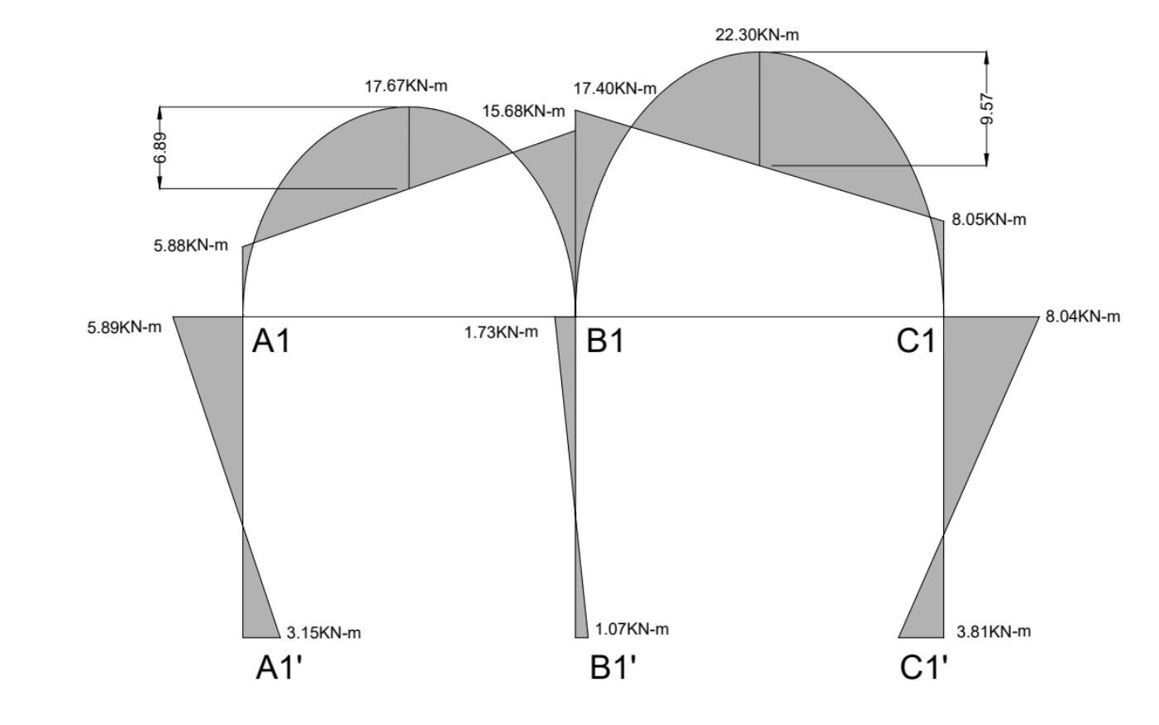
STRUCTURAL ANALYSIS
Methodology: Frame analysis executed manually using Kani’s Iterative Method for critical frames (e.g., Frame A1-B1-C1).
Key Parameters: Systematic calculation of Fixed End Moments (FEM) based on load distribution, Stiffness factors (k = 4EI/L), and Rotation Factors.
Iteration Process: Successive distribution of joint moments. Iterations were carried out until joint equilibrium was achieved and values stabilized.
Final Output: Derivation of Final End Moments to accurately construct the Bending Moment Diagram (BMD) and Shear Force Diagram (SFD) for component design.
Bending Moment Diagram
Of A1-B1-C1

Slide 7
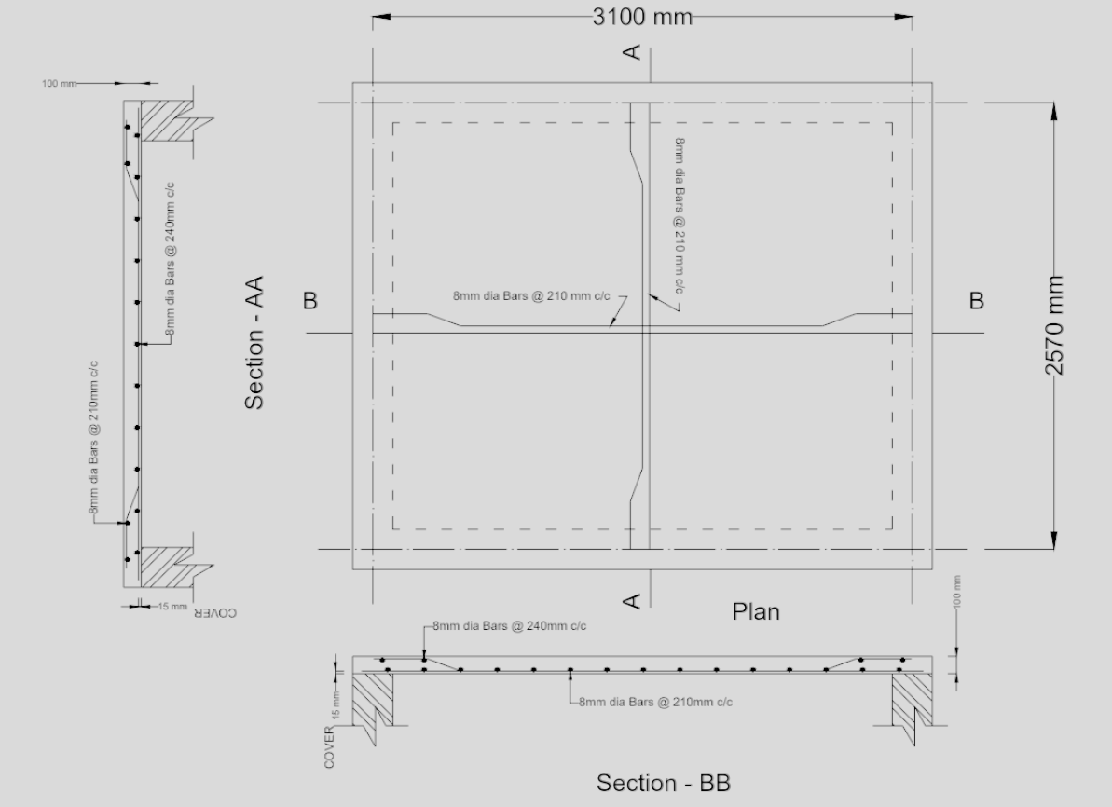
SLAB DESIGN (IS 456:2000)
Design Approach: Limit State Method (LSM) utilized as per IS 456:2000 guidelines.
Slab Classification: Designed as a Two-Way Slab, as the ratio of longer span to shorter span (Ly/Lx) is less than 2.0.
Material Specifications: M20 Grade Concrete and Fe 500 Grade Steel.
Optimized Dimensions: Overall depth restricted to 100mm to minimize concrete volume and control costs.
Safety Checks: Successfully satisfied the deflection control criteria using the appropriate Modification Factor for tension reinforcement.
Slab reinforcement

Slide 8
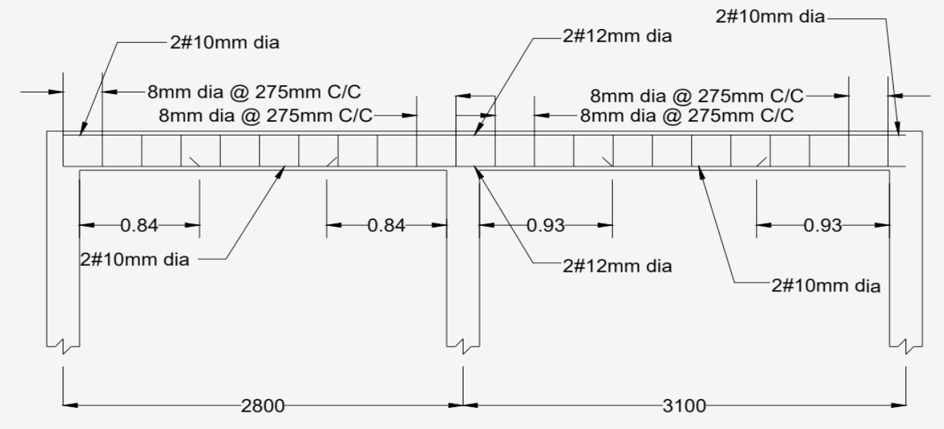
BEAM DESIGN & SHEAR REINFORCEMENT
Design Concept: Beams designed as continuous rectangular sections using the Limit State of Collapse (Flexure and Shear).
Flexural Reinforcement: Area of tension steel (Ast) calculated using maximum bending moments derived from Kani’s analysis.
Safety Protocol: Strictly designed as Under-Reinforced Sections (Mu < Mu, limit) to ensure ductile behavior and visible warning before failure.
Shear Check: Nominal shear stress (τ_{v}) was compared against the design shear strength of concrete (τ_{c}) from Table 19 of IS 456.
Shear Reinforcement: Provided 8mm Ø 2-legged vertical stirrups at 275mm c/c where τ_{v} exceeded τ_{c}.
Reinforcement details of beam A1-B1-C1

Slide 9
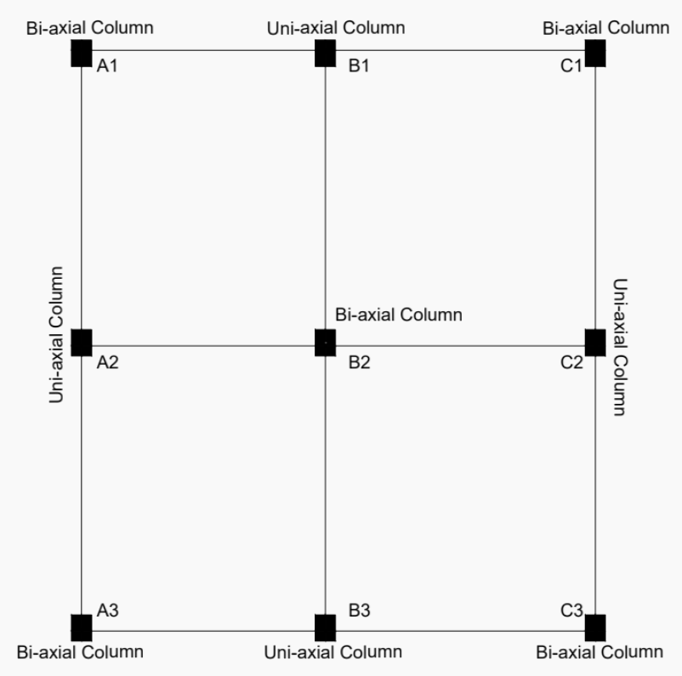
COLUMN DESIGN (UNI-AXIAL & BI-AXIAL)
Classification: Designed exclusively as Short Columns based on the effective length to lateral dimension ratio.
Load Transfer: Factored axial loads (P_{u}) and bending moments (M_{u}) accurately derived from the continuous beam reactions.
Design Variations: Column B1 (Edge): Designed for Uni-axial bending.
Column A1 (Corner): Designed for Bi-axial bending due to moments acting on both axes.
Reinforcement Strategy: Utilized SP-16 interaction charts using non-dimensional parameters (P_{u} / f_{ck} b D and M_{u} / f_{ck} b D²) to determine the optimum steel percentage (p).
Safety Verification: Safety of bi-axially loaded columns successfully verified using Bresler’s interaction equation.
Classification of column based on position and loading

Slide 10
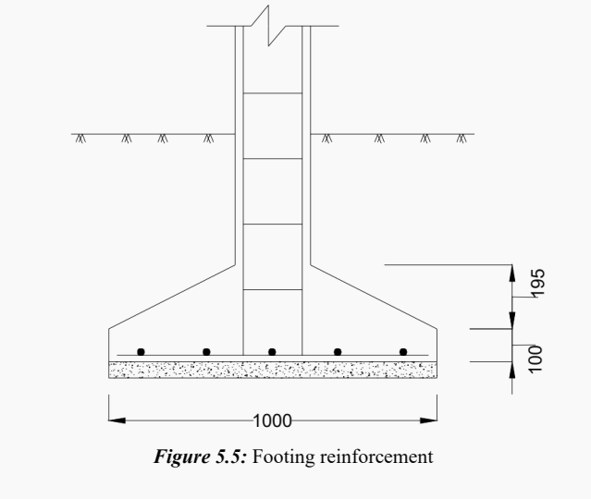
FOOTING DESIGN
Foundation Type: Isolated Pad Footings selected for individual columns to suit the G+0 load profile.
Soil Parameter: Safe Bearing Capacity (SBC) taken as 200 KN/m² based on typical regional soil strata.
Area Calculation: Base area determined using the total working load on the column plus a 10% allowance for the footing's self-weight.
Critical Depth Criteria: The effective depth was strictly governed and checked against three criteria:
Bending Moment
One-Way Shear
Two-Way (Punching) Shear
Reinforcement: Designed using the factored net upward soil pressure (q_{u}).
Footing reinforcement

Slide 11
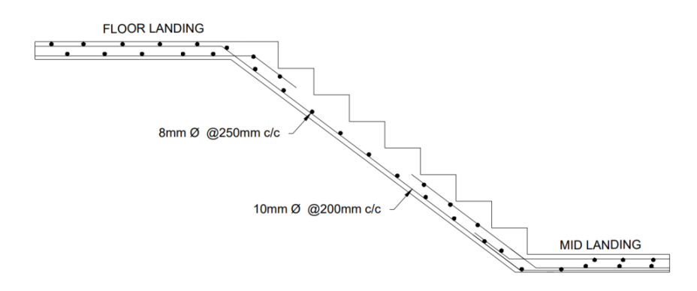
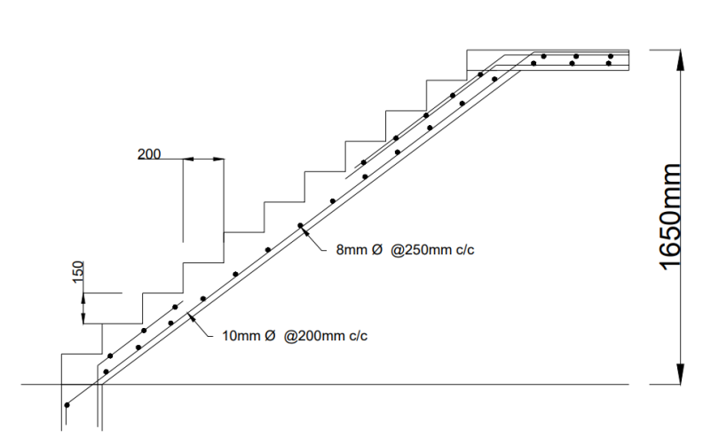
STAIRCASE DESIGN
Classification: Designed as a Dog-Legged Staircase, spanning longitudinally between supporting beams.
Proportioning: Tread (T) and Riser (R) dimensions selected for optimal residential comfort and strictly within standard NBC guidelines.
Loading Analysis: Loads calculated factoring in the self-weight of the waist slab, steps (treads and risers), floor finish, and a residential live load.
Effective Span & Depth: The effective span was determined based on support conditions, and the waist slab thickness was designed to resist the maximum bending moment.
Reinforcement: Main longitudinal steel calculated to resist flexure, with distribution steel provided across the transverse direction.
Staircase reinforcement

Slide 12
CONCLUSION & COST EFFICIENCY
Structural Integrity: The manual "Planning, Analysis, and Design" process confirms the G+0 structure is safe, stable, and fully compliant with IS 456:2000, IS 875, and NBC 2016.
Methodology Validation: Executing calculations by hand (Kani’s Method, Limit State Design) eliminated the over-estimation of materials often caused by software defaults.
Economic Success: By optimizing components (e.g., restricting slab depth to 100mm, precise steel percentage calculations), the structural framework strictly aligns with the scheme's ₹5,00,000 financial assistance limit.
Final Verdict: The project proves that rigorous, fundamental civil engineering practices can successfully bridge the gap between structural safety and economic affordability for EWS/BPL families.

Slide 13
THANK YOU
The floor is open for questions.

